Slide 1
Rock, paper, scissors, lizard, Spock.
Design Problem 2

Slide 2
Agenda
Problem Background
Learning Objectives
Coding

Slide 3
Our problem background starts in a famous TV show apartment…

Slide 4


Slide 5
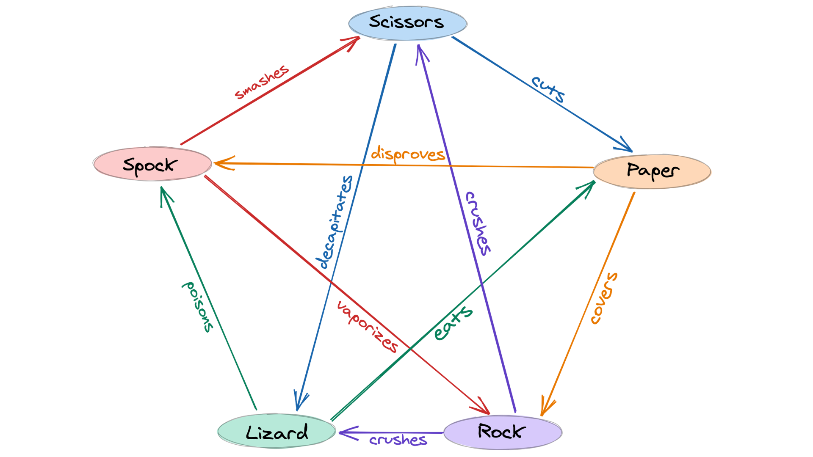
Background
Will rely on conditional statements and imported libraries to create a basic computer game!
Goal: Write a Python program that using conditional statements and user input to play Rock-Paper-Scissors-Lizard-Spock against a computer program with random choice selection.

Slide 6

Learning Objectives
Practice using many conditional statements.
Practice with user input.
Practice creating custom functions.
Practice with built-in libraries.

Slide 7
Engineering Design Process
Learn to define the problem.
Practice defining test cases.
Develop an algorithm plan (i.e. a workflow!).
Program your solution and debugging.

Slide 8
Some reminders.

Slide 9
Function Definitions
Definition
Function Name
Colon
def function_body(parameters):
body
Indent
(parameter1,
parameter2, …)
What is in the body?

Slide 10
Function Definitions
def function_body(parameters):
1. “““DOCSTRING””” (optional)
2. Code the does the thing
3. return [expression]
The return statement is options and if it is not included, it’s the same as writing return None

Slide 11
Calling Functions
In Python names of variables and functions use low case and underscores.
function_name
Function_Name
FunctionName
The general form of a function call:
Terminology
argument: a value given to a function.
pass: to provide an argument to a function.
call: ask Python to execute a function (by name).
return: give a value back to where the function was called from.
function_name(arguments)

Slide 12
Input
Python has a built-in function named input for reading text from the user.
The general form of a input function call:
The argument is the text you want displayed to the user.
“What is your name?”
The value returned by the input function is always a string.
input(argument)

Slide 13
Importing Functions and Modules
The general for of an import statement is:
import module_name
To access a function within a module:
module_name.function_name

Slide 14
Rock, paper, scissors, lizard, Spock.
Design Problem 2

